Slide 1
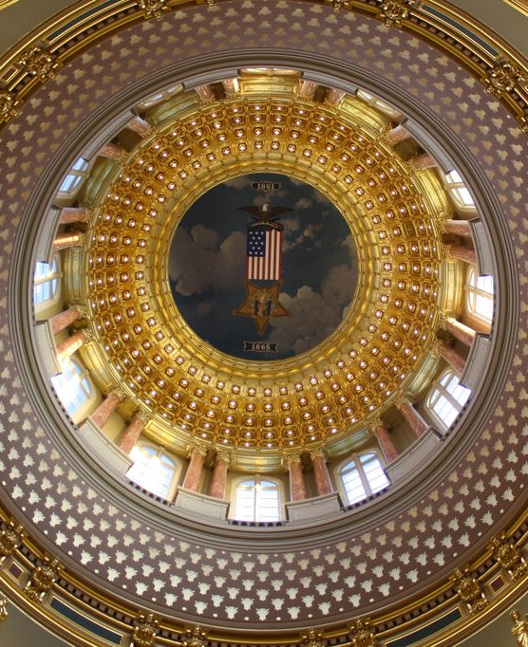
Advocating Environmental Health
Doug Farquhar, JD
dfarquhar@neha.org
December 2023

Slide 2
What is Policy Making?
Legislative processes and procedures are complex, but not without logic and able to be comprehended.
It takes an effort to become engaged in the legislative process from any vantage point.
Legislative processes and procedures are designed for deliberation, broad input and compromise.
Few bills become law; about 10 percent on average each year.
Around 175,000 bills are introduced annually in the 50 states, District of Columbia and Puerto Rico

Slide 3
Authority to Govern
Constitutions (U.S. and State) - which set forth the basic parameters of a government and its administration (including public health and the environment)
Statutes (Congress and State Legislatures) - which determine the policies of a government and limitations on individuals for the overall good; limited by the rights and obligations set forth in the appropriate Constitution
Regulations (Federal and State Agencies) - the rules established by agencies in the executive branch to implement and administer statutes
Common Law – those legal theories that have evolved via decisions by the courts
International Law (U.N., Federal Foreign Policy) – Treaties, Protocols, Agreements
Notes:
Policy consists of a formal set of plans and principles intended to address public problems. It is a tool to encourage or discourage an action or inaction in response to a public concern. Public policy is made by governments on the behalf of their constituents, be they local, tribal, state, federal or international. They seek to serve the public and improve the public’s welfare.
A government’s ability to implement these approaches comes from the authority their constituents grant them to impose these policies. The public grants Congress, the state legislatures, the city, county and tribal councils, the authority to impose restrictions on its citizens and requires certain businesses to act in specific ways that limit environmental emissions that harm human health.
This grant of authority comes through four mechanisms – Constitutions, statutes, regulations and the common law.
In this chapter the term ‘law‘ refers to the rights and responsibilities of individuals and governments within a society. It provides the mechanisms to require the persons creating pollution to compensate others for the damage caused by pollution. Because of the law, persons and entities releasing wastes into air, water and on land can be required to rectify their actions to persons who bear the health burdens of the wastes.
Governed via 4 sources of law:
Constitutions (U.S. and State) - which set forth the basic parameters of a government and its administration (including public health and the environment)
Statutes (Congress and State Legislatures) - which determine the policies of a government and limitations on individuals for the overall good; limited by the rights and obligations set forth in the appropriate Constitution
Regulations (Federal and State Agencies) - the rules established by agencies in the executive branch to implement and administer statutes
Common Law – those legal theories that have evolved via decisions by the courts

Slide 4
Constitutions
Constitutions establish the framework of how a government intends to operate.
The U.S. Constitution is the source for all legal authority for the federal government.
The Congress, President and Judiciary operate within the constraints of this document.
Neither the term ‘public health’ nor ‘environment’ is not mentioned in the U.S. Constitution.
Federal authority to regulate the environment emanates from its authority to regulate commerce between the states (Commerce Clause) and its authority to tax and spend.
Notes:
The U.S. Constitution is the source for all legal authority for the federal government. The Congress, President and Judiciary operate within the constraints of this document. However, neither the term ‘public health’ nor ‘environment’ is mentioned in the Constitution. Much of the federal authority to regulate environmental health emanates from its authority to regulate commerce between the states (Commerce Clause) and its authority to tax and spend. This leaves the primary responsibility for environmental public health left to the states and locals (via the 10th amendment to the U.S. Constitution).

Slide 5
Constitutions
Constitutions establish the blueprint for how a government intends to operate
  Determines how its constituents will be governed
  Establishes how laws will be enacted, who these laws may govern, and how these laws will be administered
U.S. Constitution is the source of all legal authority for the federal government
State constitutions are source of legal authority for the states
State constitutions differ in significant ways, producing different styles of government in the states
  U.S. Constitution, world’s oldest constitution, is 4,400 words
  Alabama Constitution, world’s longest constitution, is 310,296 words
Notes:
Constitutions establish the framework of how a government intends to operate. A Constitution determines how constituents will be governed, what rights will be granted and how the government will operate. These documents set forth how laws will be enacted, who may be subject to these laws, and how the laws may be administered.
As with the federal government, state and local governments are limited by their own constitution, as well as the U.S. Constitution. This can range from the manner in which a state adopts tax policy to limitations on regulating private property. Constitutions can limit the extent a government may regulate individual rights, or they may expand the authority of the public (i.e., the government) over an individual. Each constitution provides for the establishment of state and local government powers. Legislatures have the authority to determine the rights and responsibilities of activities on government lands (as the owner) or can act under authority of police powers (as a regulator).

Slide 6
10th amendment – authority reserved to states
“The powers delegated by the proposed Constitution to the federal government, are few and defined. Those which are to remain in the State government are numerous and indefinite. … The powers reserved to the several States will extend to all the objects which, in the ordinary course of affairs, concern the lives, liberties, and properties of the people, and the internal order, improvement, and prosperity of the State.”
- James Madison, Federal Papers #45
Notes:
The 10th Amendment to the Constitution states: “The powers not delegated to the United States by the Constitution, nor prohibited by it to the States, are reserved to the States respectively, or to the people.” The Constitution’s enumerated powers to the federal government do not include the environmental or public health. Through the 10th Amendment states retain responsibility for environmental health.

Slide 7
10th amendment – authority reserved to states
State and local governments retain all police powers not expressly granted to the federal government. This includes the authority to protect and promote the public’s health and safety.
This leaves the state and local governments with broad authority to regulate public health and safety and to protect the environment. Most environmental public health activities are enacted by and carried out by the state and local governments.
Notes:
State and local government retain all police powers not expressly granted to the federal government. This includes the authority to protect and promote the public’s health and safety, as well as promote the common good.

Slide 8
Statutes
Statutes are Laws adopted by the legislature (Congress, the state legislatures, the county commissioners, tribal or city council) on behalf of the public
  Clean Air Act, Clean Water Act, Chemical Safety Act, Food Safety Modernization Act
Police powers are powers exercised by the states to enact legislation and regulation to protect the public health, welfare, and morals, and to promote the common good
Notes:
Statutory Laws are the laws adopted by the legislature (Congress, the state legislatures, the county commissioners, tribal or city council) on behalf of the public (i.e., Clean Air Act, Clean Water Act, Chemical Safety Act, Food Safety Modernization Act). Legislative bodies have the authority to determine the rights and responsibilities of actions on federal (or other governmental) lands as the owner, and can act under authority of police powers when demanding a facility release less pollution. Police powers are powers exercised by the states to enact legislation and regulation to protect the public health, welfare, and morals, and to promote the common good.

Slide 9
Statutes
Statutes are passed by Congress and/or the state legislatures
Adopt agency ‘organic’ acts, which establish the basic scope and authorizations of an agency
  Grants authority to the secretary of health to address public health concerns
Statutes give power to executive branch agencies, such as health and environmental departments, to administer the parameters of the law
Notes:
Statutes are the laws and policies adopted by the people’s branch of government – the legislatures. Legislatures include the U.S. Congress, the state legislatures, and to some extent, the city and tribal councils, and county commissioners. Their legitimacy to govern comes from the fact that they are elected by the people whom they govern; the same people who have the opportunity to vote them out if they disagree with the laws they enact. This concept often makes elected bodies cautious and engaged in a constant balancing act: they do not want to limit freedoms or restrict their constituents unless its critical to the public’s health or safety.

Slide 10
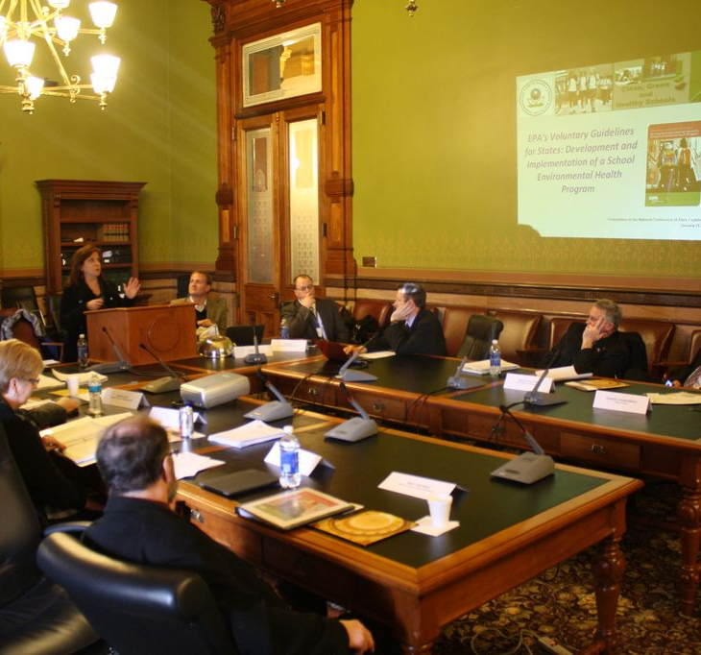
Legislatures
Legislatures include the U.S. Congress, the state legislatures, and to some extent, the city and tribal councils, and county commissioners.
They are elected by the people whom they govern; the same people who have the opportunity to vote them out if they disagree with the laws they enact. This concept often makes elected bodies cautious and engaged in a constant balancing act: they do not want to limit freedoms or restrict their constituents unless its critical to the public’s health or safety.
Notes:
Most states governments are similar to the federal system: two legislative chambers (House and Senate), an executive (the Governor and administrative agencies), and a Judicial Branch. Although within these systems there are great differences, which make the adopting of a law either easier or more challenging. School House Rock ‘I’m Just a Bill.’
For example, in California, the legislature enacts statutes requiring state agencies to perform specific functions, but it is the responsibility of the Governor to fund such measures. Colorado’s legislature does not have the authority to raise taxes or expand the state government without the measure being subject to a popular vote. Nebraska only has one chamber – the Senate. North Carolina and Texas limit the Governor’s authority; all statutes and budgetary decisions are made by the legislature. In eight states, the legislatures meet year round; in four states they meet every other year. Each variance makes it either easier or more difficult to adopt a statute.
And then there’s Louisiana.

Slide 11
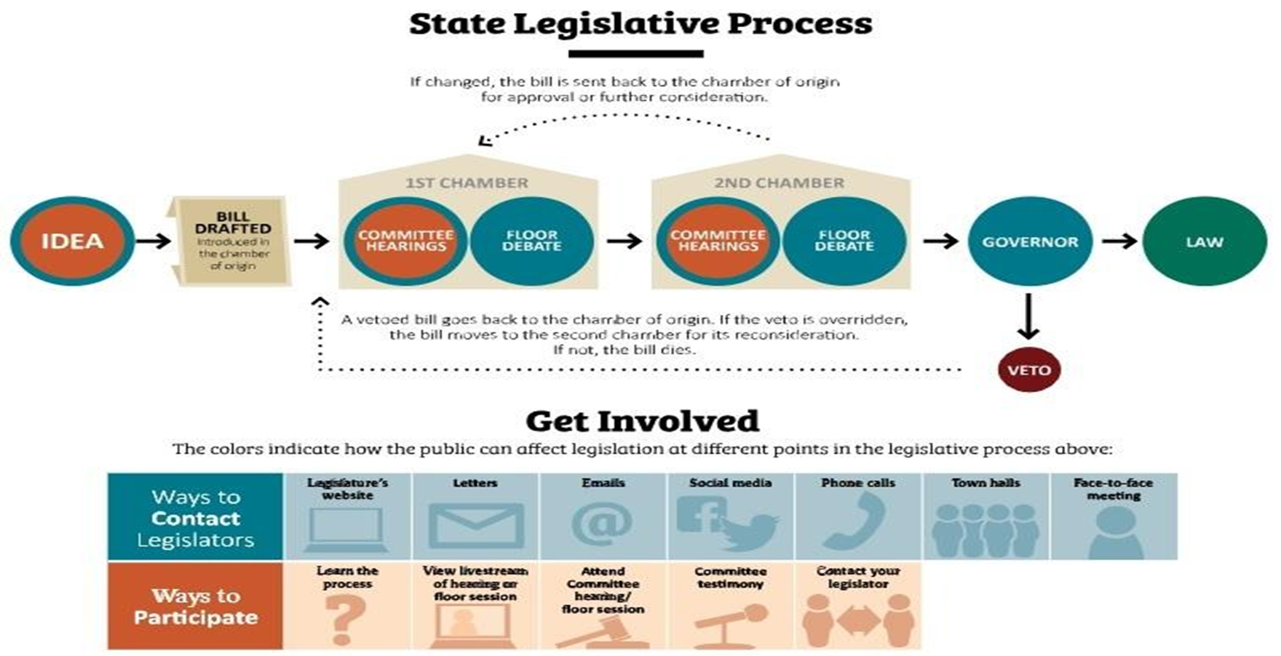
Legislative process
Notes:
Enacting a statute involves an introduction of a bill by a legislative member, testimony on the merits of the bill before legislative committees, passage of the bill before the legislative chamber, and then duplicating the process in the other chamber. Upon passage, the bill may be signed or vetoed by the Executive (President or Governor). After enactment, the bill may be subject to a court challenge questioning whether the law violates the federal or state constitution.

Slide 12
Regulations
Agencies promulgate regulations to direct the implementation of a law enacted by the legislature.
Regulations must be published in advance, provide the public the opportunity to comment, often provide for a public hearing, and require the agency to respond to the public’s comments.
Agencies then publish a final rule, which may be challenged in the courts if it fails to meet the scope and authority of the statute that the agency implements.
Both the executive and the legislature retain authority over agency regulations.
Notes:
Environmental law receives its authority from the legislature, which represents the people. The administrative agencies (federal, state and local) administer the law, under the power provided to them by the legislature. This means the scope of an agency’s authority is limited by the authority granted to it by its legislature and its Constitution.
In promulgating regulations, agencies are subject to many of the procedures that legislatures face in enacting statutes. Regulations must be published in advance, provide the public the opportunity to comment, often provide for a public hearing, and require the agency to respond to the public’s comments. Agencies then publish a final rule, which may be challenged in the courts if it fails to meet the scope and authority of the statute that the agency implements.
Both the executive and the legislature retain authority over agency regulations. The executive (Governor or President) appoints the agency director, who is responsible for the agency’s overall direction and the regulations it promulgates. The legislature controls the appropriations that either support or limit the agency’s resources to implement a regulation. Federal grants have become a major source of funding for state agencies, however several state legislatures often retain the right to accept or reject federal funds.

Slide 13
Regulations
Legislatures can give agencies the power to make regulations that have the same force as statutes
  Legislatures delegate that specific authority to the agency
Regulations allow agencies to respond to new challenges because they can be enacted and modified more quickly than statutes
Federal and state laws require agencies to allow the public to participate in rule making
Notes:
Regulatory environmental public health agencies are resource intensive, requiring staff to implement requirements of the law as well as staff to ensure enforcement. Enforcing laws requires oversight of record keeping, monitoring of actions, identification of violations and prosecution of those violations. Federal regulatory environmental health agencies include the Environmental Protection Agency (EPA), the Food and Drug Administration (FDA), Occupational Safety and Health Agency (OSHA) and the U.S. Department of Agriculture (USDA).
Non-regulatory agencies require fewer staff resources, because they do not set enforceable standards and ensure those standards are met. This allows these agencies to focus on research and data-gathering, providing guidance to the public on EPH threats and possible responses. The Centers for Disease Control and Prevention (CDC), the Agency for Toxic Substances and Disease Registry (ATSDR), the National Institute for Environmental Health Science (NIEHS) and National Institute for Occupational Safety & Health (NIOSH) are a few of the non-regulatory federal environmental health agencies.

Slide 14
Administrative agencies
The administrative agencies (federal, state and local) administer the law, under the power provided to them by the legislature.
An agency’s authority is limited by the authority granted to it by its legislature and its Constitution.
Regulatory agencies (EPA, FDA) have the authority to promulgate enforceable requirements that mandate certain parties must perform certain activities, or face fines.
Non-regulatory agencies (CDC) provide research and assistance, but cannot promulgate enforceable regulations.
Notes:
When a legislature enacts a statute it implicitly authorizes the executive to act via the state agencies. For environmental health statutes, most often these are administered by the states’ department of health or department of environment. For statutes related to food safety, several states regulate these programs through their department of agriculture.
The legislature determines the scope and authority of the agencies to address certain issues; agencies cannot regulate issues outside of this scope. Agencies promulgate regulations in response to a statutory law, establishing the manner in which the law is administered and operated.

Slide 15
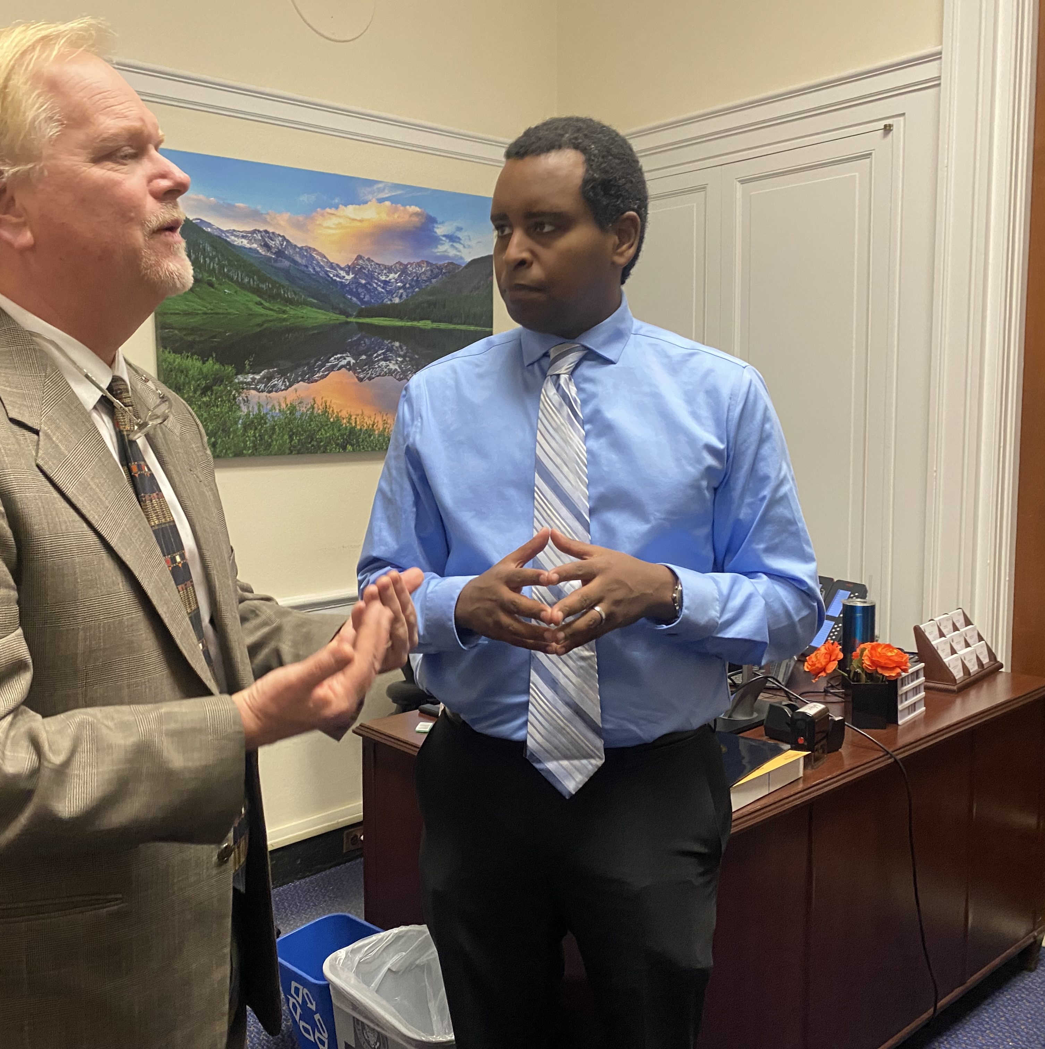
Lobbying – 502 (c)(3)
Use of funds to directly lobby is likely to be restricted or prohibited by contract or grant if using federal dollars
Private funds (RWJ, Pew, Mott) may or may not have restrictions

Slide 16
Lobbying – 502 (c)(3)
Requires ALL four elements
Communication with a
Government official or employee who participates in forming legislation that
Reflects a point of view (i.e., attempts to influence) on
Specific Legislation: appropriation, regulation, administrative action, executive order, legislation
If one of these elements is missing, it is not lobbying!
Notes:
Normal and recognized executive-legislative relationships or Participation by an agency or officer of a State, local or tribal government in policymaking and administrative processes within the executive branch of that government.
A health department typically provides an annual state of the health report to elected officials with recommendations for legislative action.
• State legislative liaisons typically consult local health agencies about pending legislation.

Slide 17

Communication
E-mail
Phone Call
Letter
In-person meeting
Tweets or posts on social media
Most any form of influence

Slide 18

Government Official
Anyone working for:
a legislative body, a legislator, or other government agency/department that takes part in forming legislation

Slide 19
Influencing Legislation
Reflecting a particular view about the legislation or making a direct appeal

Slide 20
Allowable Activities
Nonpartisan Analysis, Study or Research on policy alternatives or specific legislation that may express support for a specific policy
Response to an invitation to testify or provide technical assistance
Educating the public about personal health behaviors
Communicating to the public about health risks and their consequences
Talking with legislators or legislative staff about policy and issues
Inviting legislators or their staff to site visits to help them gain a deeper understanding of public health issues
Working with private sector organizations on voluntary institutional changes that do not constitute public policy
Engaging in regulatory affairs
Notes:
1. Independent, balanced and objective;
2. Fair to both sides of an issue (contains a full and fair exposition of the pertinent facts);
3. Allows a reader to draw own independent opinion or conclusion though author may include their own
opinion or conclusion;
4. Conclusion is based on evidence and facts, not on unsupported opinion;
5. Broadly distributed to the public, and not directed to only one side of an issue.

Slide 21
So how does a legislator learn about an issue?
  Lobbyists for Corporation/Business Interests
  Concerned Citizens – state & local associations promoting environmental or public health
  Impacted Constituents – ones that may have been affected by a public health action
  Agency Legislative Liaison – lobbies on behalf of agency, not environmental health
  Subject-Matter experts, within or outside of government
Notes:
1. All governments and nonprofits are allowed to conduct lobbying activities.
2. Your lobbying activities may be restricted by a funder or under a particular state or local law.
3. Consult your legal counsel about your particular grants/contracts and state/local laws.
4. NEVER contact your legal counsel, the answer will be NO.

Slide 22
5 Stages of Legislative Policy Making
Denial – I grew up in Kellogg, ID, with lead tailings everywhere. And I did fine. I’m a State Senator – Sen. Peitch, ID
Anger – The EPA is totally out of control. And the CDC isn’t much better – Rep. Gary McPherson, CO
Bargaining – Can we take the EPA money and simply not do the program? – Michigan Legislative Committee
Depression – I fear for the future of our country – Rep. Carl Gatto, AK
Acceptance – I’d rather have Mississippi run this program than the EPA – Sen. Moffatt, MS
Notes:
If you engage in lobbying, maintain accurate and detailed records that distinguish between your lobbying and non-lobbying activities.
Standard time reporting is sufficient to show that grant funds were not used for lobbying activities.

Slide 23
Advocating for Environmental Health
  Lobbying is allowed, unless there are specific restrictions
  There are many allowable activities regardless of lobbying restrictions
  Carefully separate personal and professional lives
  Consult your legal counsel about your particular grants/contracts and state/local laws.
  NEVER contact your legal counsel, the answer will be NO!
Notes:
1. All governments and nonprofits are allowed to conduct lobbying activities.
2. Your lobbying activities may be restricted by a funder or under a particular state or local law.
3. Consult your legal counsel about your particular grants/contracts and state/local laws.
4. NEVER contact your legal counsel, the answer will be NO.

Slide 24

Notes:
Registration is now open for the NEHA 2024 Annual Educational Conference & Exhibition July 16-18 in Pittsburgh, PA and virtually.
Seize this opportunity to learn, network, and contribute to the environmental health community.
Participating not only expands your environmental health knowledge but also contributes to creating a connected and skilled workforce.
We look forward to welcoming you to Pittsburgh!

