Slide 1
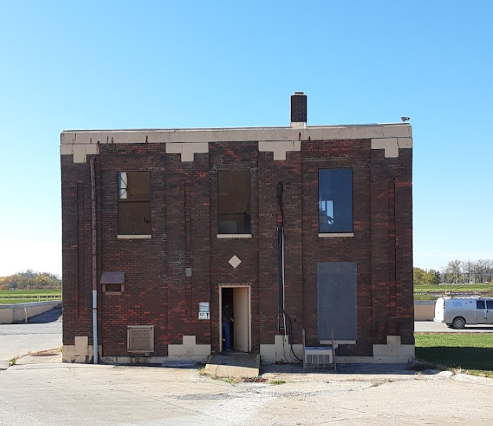
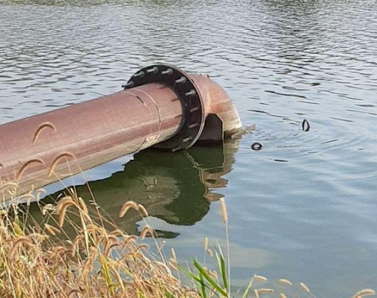
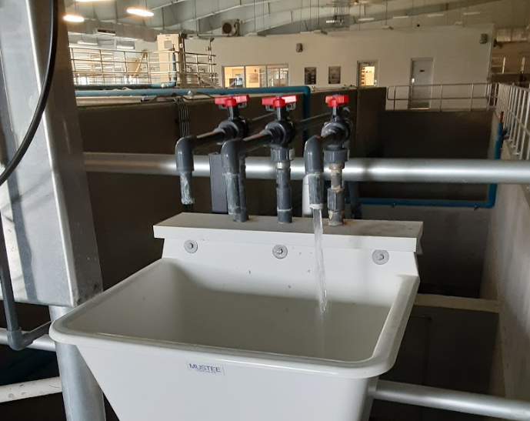
Iowa DNR Update
Erik Day
All Federal Rule and Public Data courtesy of Jim Warren
August 2023

Slide 2
Agenda
PFAS
Background
EPA Proposed PFAS Regulation
Results
Water Supply Protocol
Private Wells
Notes:
Outline of the presentation

Slide 3
PFAS: Background
Per and poly-fluoro alkyl substances (PFAS)
More than 12,000 compounds
Man-made and in many products due to it’s ability to repel water & oil and heat resistance
Pots & pans, stain resistant carpets, fire fighting foam, etc.
Persistent in environment
Do not degrade
C-F bond is one of the strongest known
Accumulates in the environment and in organisms
Mobile - atmosphere, surface water, soil, etc.
Exposure is considered a health risk
Notes:
PFOA = perfluorooctanoic acid
PFOS = perfluorooctane sulfonic acid
3

Slide 4
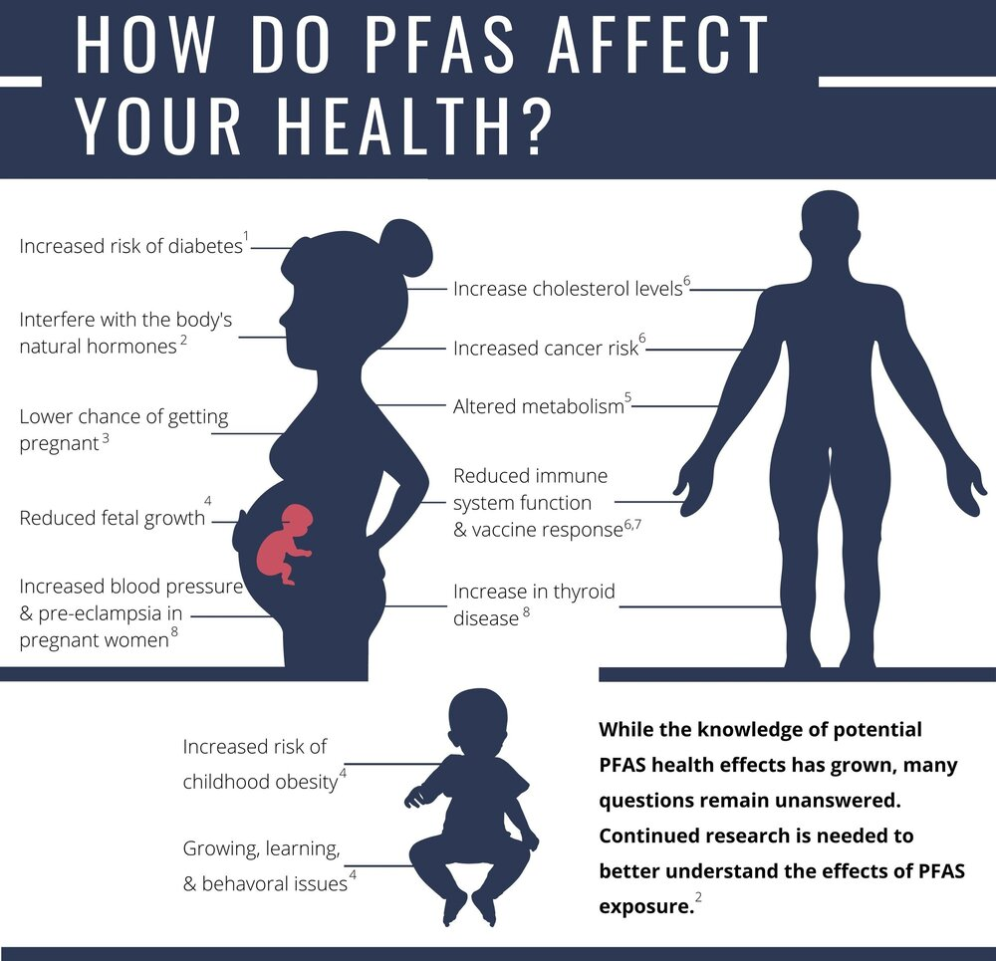
Figure and citations from https://www.wehnonline.org/pfas

Slide 5
PFAS: EPA Health Advisories and Proposed Rule
PFAS usually measured in nanograms per liter (ng/L) or parts per trillion
EPA is proposing to regulate 6 PFAS compounds
PFOA & PFOS regulated as individual contaminants
GenX, PFBS, PFHxS, & PFNA regulated as a mixture (Hazard Index – HI)
*Health Based Water Concentration
PFAS Compound | Health Advisory (pre-June 2022) | Health Advisories (June 2022) | Proposed MCL
PFOA | Individual or Combined total 70 ng/L | Interim = 0.004 | 4.0
PFOS |  | Interim = 0.02 | 4.0
PFBS | - | 2000 | 2000*
GenX (includes HFPO-DA) | - | 10 | 10*
PFNA | - | - | 10*
PFHxS | - | - | 9.0*
Notes:
Colors are consistent with summary figures

Slide 6
PFAS: EPA Proposed Rule
What is a Hazard Index (HI)?
Tool used to evaluate health risks from simultaneous exposure to mixtures of certain chemicals. It is a ratio based calculation.
This applies to GenX, PFBS, PFNA, & PFHxS
How is the HI calculated?
For each of the four PFAS above, the calculation first divides the results of the drinking water sample by the HBWC and then adds all the values for each PFAS.
An exceedance occurs if the Health Index is calculated to be 1.0 or higher.

Slide 7
Hazard Index Calculation
EPA (2023, March 29) Proposed PFAS National Primary Drinking Water Regulation
www.epa.gov/system/files/documents/2023-04/PFAS%20NPDWR%20Public%20Presentation_Full%20Technical%20Presentation_3.29.23_Final.pdf

Slide 8
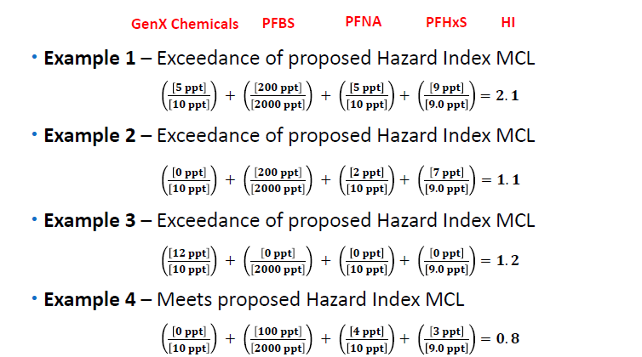
Hazard Index RAA Calculation Example
2.1 + 1.1 + 1.2 + 0.8 = 5.2
5.2/4 = 1.3 – MCL Exceeded
Notes:
PFBS would have to be over 2100 to make the ratio greater than 1.0.

Slide 9
PFAS: Proposed Monitoring Requirements
Initial Monitoring
Must be completed within a 3 year period between rule promulgation and rule effective date (anticipated end of 2023 – 2026)
Quarterly monitoring for one year for all surface water systems
Quarterly monitoring for one year for groundwater systems serving greater than 10,000
2 samples within one year at least 90 days apart for groundwater systems serving less than 10,000
Based on the results of initial monitoring, quarterly or reduced monitoring will be assigned.
Systems will be able to use previously collected samples to comply with initial monitoring (UCMR5, DNR PFAS Data)

Slide 10
Proposed Monitoring Requirements Continued
Compliance Monitoring - based on Initial Monitoring results
Rule Trigger Level = 1/3 of Proposed MCLs; Determines Compliance Monitoring (Quarterly or Reduced)
PFOA and PFOS = 1.3 ppt
Hazard Index (GenX, PFBS, PFNA, PFHxS) = 0.33
If the average of Initial Monitoring is greater than or equal to the trigger level, the system must conduct quarterly monitoring
If the average of Initial Monitoring is less than the trigger level, the system may conduct triennial monitoring (reduced monitoring)
Changes in Monitoring
A system on quarterly monitoring may go to reduced monitoring if the RAA is less than all trigger levels.
A system on triennial monitoring that exceeds a trigger level must conduct quarterly monitoring.

Slide 11
Propose Public Notice & Treatment Requirements
Public Notice
If the MCL or Hazard Index RAA is exceeded, a tier 2 public notice will be required.
Tier 2 – as soon as possible, but within 30 days of the violation
Results will need to be included in the CCR for detects of the 6 regulated compounds.
Must report levels of regulated PFAS detections in finished water
Must report potential health effects of the regulated PFAS in violation of the MCL or Hazard Index
Treatment
Systems above the MCLs will be required to install treatment, or take action to meet the MCLs
EPA identified the following as best available treatment technologies
Granular Activated Carbon (GAC)
Anion Exchange (AIX)
Nanofiltration (NF) and Reverse Osmosis (RO)
Blending or alternative sources can also be used to meet the MCLs

Slide 12
Iowa Bipartisan Infrastructure Law (BIL) Funding
PFAS in FY2022 – FY2026 (5 years)
The Bipartisan Infrastructure Law provides $105 million to invest in drinking water systems specifically impacted by PFAS and other emerging contaminants.
$57,917,000 million through the Drinking Water State Revolving Fund (DWSRF)
$47,285,000 million through EPA's Emerging Contaminants in Small or Disadvantaged Communities Grant Program
Iowa SRF can also leverage an additional $155 million in BIL DWSRF general supplemental funds for loans to make drinking water safer.
Questions contact:
Funding: Theresa Enright – 515-725-0498 theresa.enright@dnr.iowa.gov
Water Supply Engineering Projects: Tara Naber – 515-725-0292 tara.naber@dnr.iowa.gov
Funding questions: Contact Theresa Enright phone email
Water Supply Engineering Questions: Tara Naber phone email

Slide 13
PFAS: EPA Proposed Rule – Public Comment & Resources
Public Comment Period – 60 days
The Public Comment Period was from March 29, 2023 to May 30, 2023
May 4 EPA held a virtual public hearing where oral comments were made
Iowa commented on the rule through the Association of State Drinking Water Administrators (ASDWA)
Fact Sheets, Frequently Asked Questions, Presentations
Located on EPAs PFAS website: https://www.epa.gov/sdwa/and-polyfluoroalkyl-substances-pfas

Slide 14
DNR Action Plan
Focus Area 1: Identify and Minimize Exposure of Iowans to PFAS in Public Drinking Water
Initial Actions Taken
Developed a surveillance project to evaluate the presence of PFAS in Iowa drinking water
Used a phased approach prioritizing testing of public drinking water systems
Developed protocols
Data driven decisions
Notes:
-PFAS Action Plan finalized in January 2020 is on our website.
-Develop a surveillance to assess the occurrence and distribution of PFAS in Iowa, and was not designed to determine the sources of PFAS compounds.
14

Slide 15
Study Design and Justification
Raw water samples to assess patterns related to susceptibility and to inform supplies about where PFAS are entering their systems
Treated water to assess what is actually going to drinking water users and to prepare for anticipated standards
Unique: Our study is unlike those from most other states. We have collected matching sample pairs of raw water and finished drinking water.
All surface water supplies– susceptibility to potential sources across watersheds and atmosphere
Groundwater – focus on high susceptibility wells in close proximity to potential sources
Targeted and iterative approach – biggest bang for the buck, learning as we go and when warranted, returning to some locations to gather more data or help communities in need.
Notes:
Compare to other states processes and talk about value of our approach
What an iterative approach is and give examples.

Slide 16
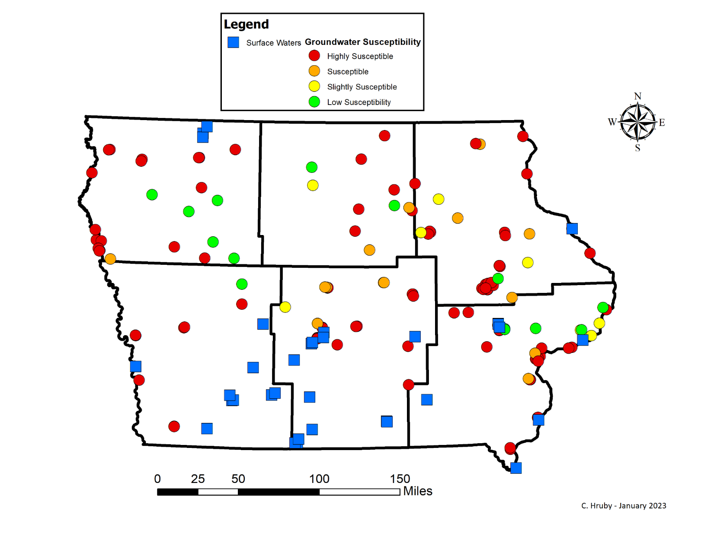
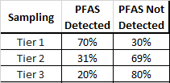
Tiers 1, 2, & 3 - Monitoring Locations
Locations chosen based on susceptibility to contamination and proximity to potential sources
Notes:
Other states tried to sample the whole universe of water sources, but Iowa’s approach was to focus on high priority sites first in a Tiered approach. Tiered approach worked! We will continue to prioritize highly susceptible wells.

Slide 17
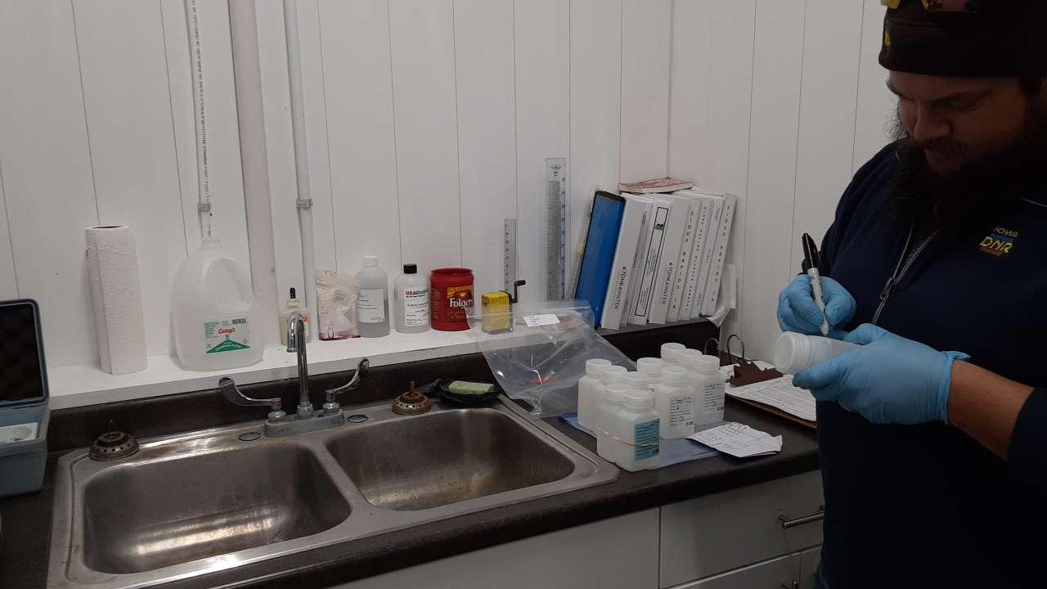
Quality Assurance
All 120 blanks were negative for PFAS compounds
Duplicate samples averaged 3% difference
Sample SOP on website –add link
Notes:
No detections in any of the blanks!
<5 % difference for most dups. All dups <10% different for all PFAS compounds, except 1 (12.5%)

Slide 18
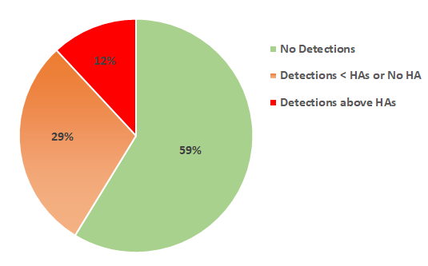
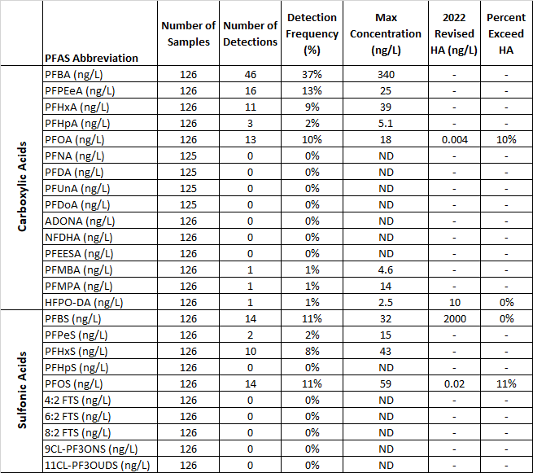
PFAS Detections in Finished Water
126 finished water samples
116 public water supplies
PFBA most commonly detected (37% of samples)
PFOA and PFOS exceeded revised HAs
PFBS and HFPO DA never exceeded new HAs

Slide 19
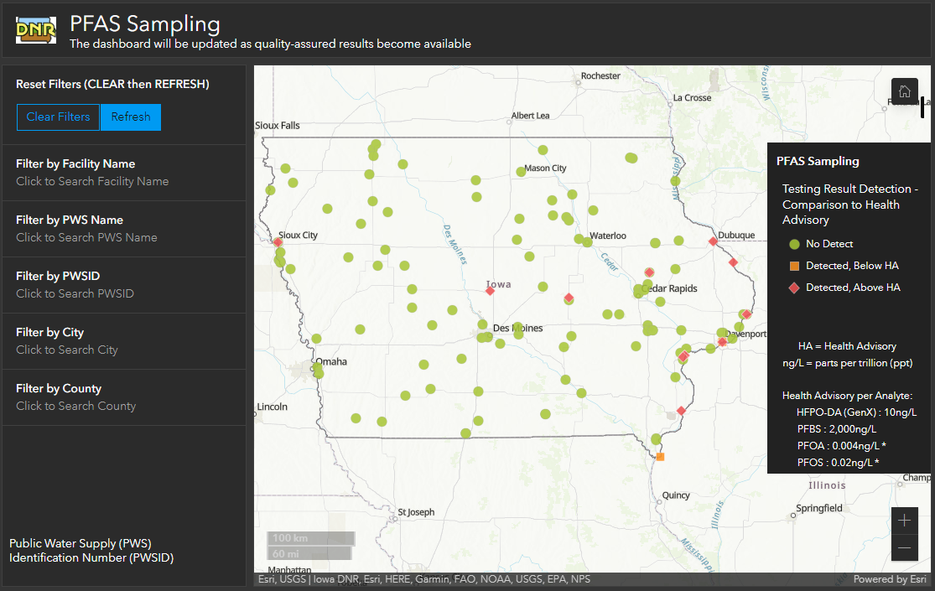
Interactive Map
Notes:
Updated legend when HAs were revised. Some communities stopped using wells with PFAS, so they now appear green.

Slide 20
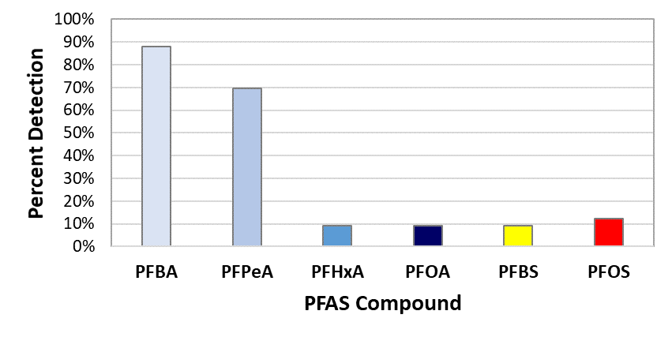
Raw Surface Water PFAS Detections
Notes:
33 locations (21 lakes, 12 rivers)
Only 6 compounds, but 2 were common at low levels.
PFBA - perfluorobutanoic acid
PFPeA - Perfluoropentanoic acid
Most PFBA concentrations below 7 ppt
Mississippi River 29 - 32 ppt
PFOS and PFOA less than 3.8 ppt

Slide 21
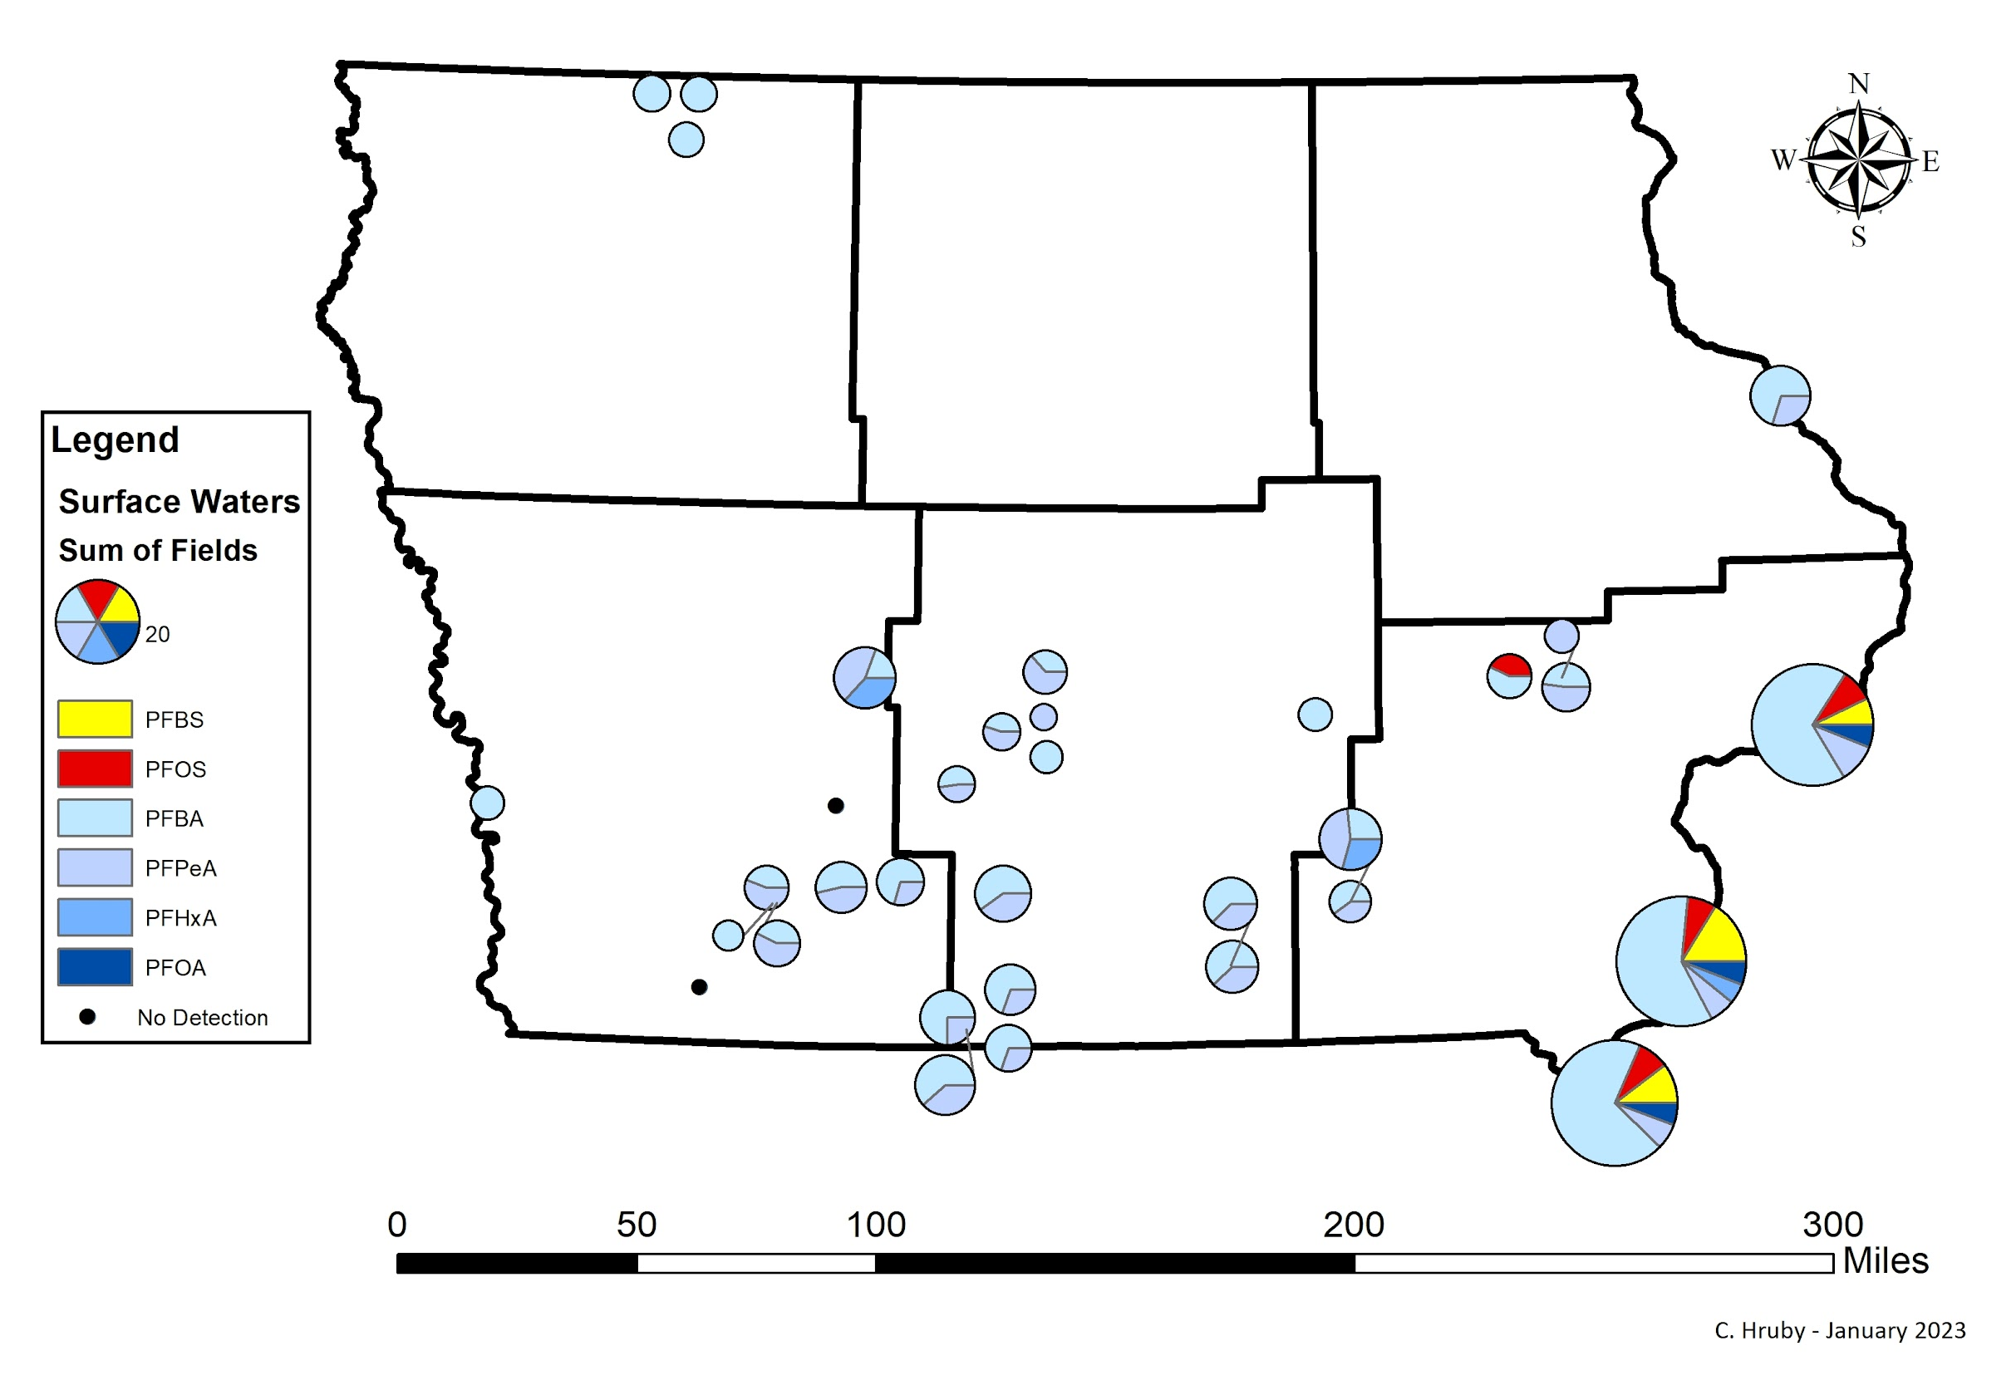
PFAS in Surface Waters (untreated river and lake water)
Notes:
Pie charts are used to give us an idea of the mixtures of compounds found at each location. Again, PFBA is widespread at low levels. PFOA, PFOS, PFBS in Mississippi.
Ubiquitous occurrence, but just a few compounds

Slide 22
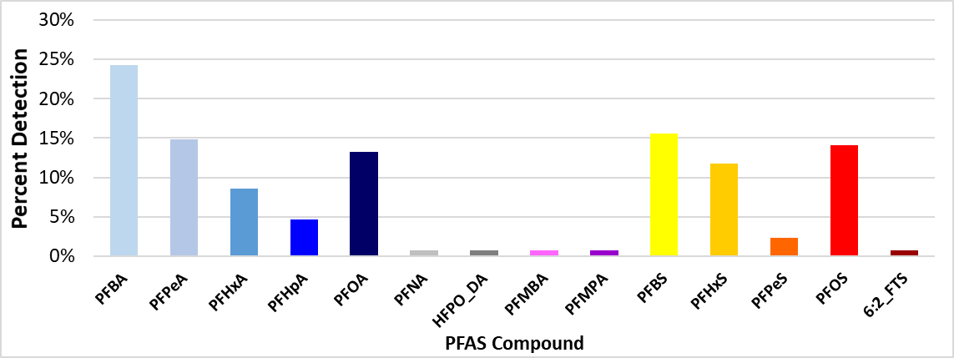
Raw Groundwater PFAS Detections
Notes:
PFOS - max concentration is 60 ppt
PFOA - max was 29 ppt

Slide 23
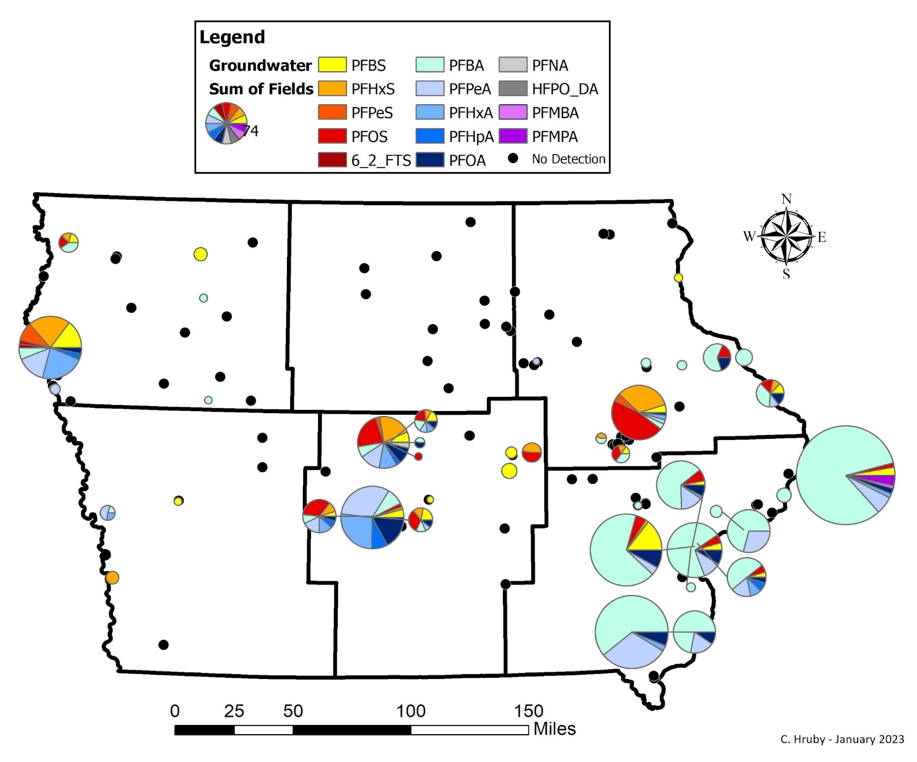
PFAS in Wells (untreated groundwater)
Notes:
Update to include Tier 3 – to date
Fingerprintable!
Alluvial wells along Mississippi look more like surface water

Slide 24
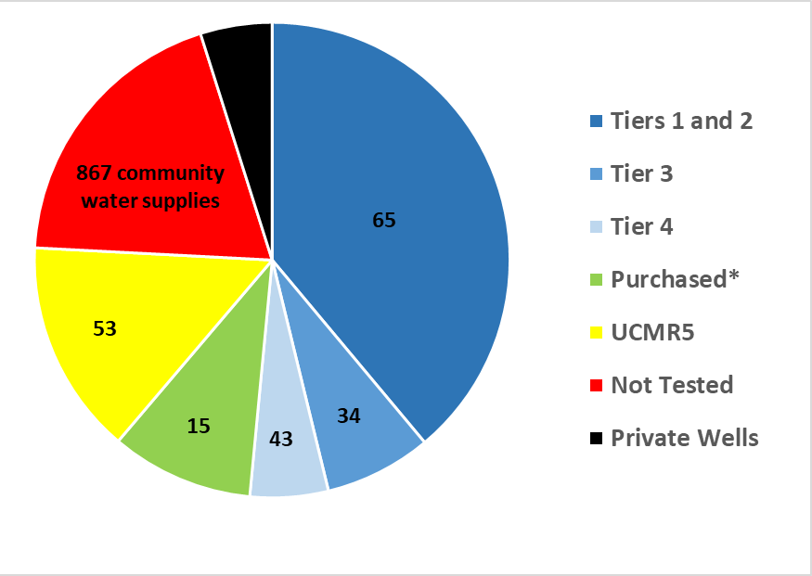
Iowa Population Represented by Sampling
* = Communities that purchase water from supplies tested in Tiers 1 -3.
Notes:
This is just for community water supplies. We tested NTNCs and one NC in addition. Of the 867 public supplies that have not been tested, 157 contain highly susceptible wells and will be prioritized for Tiers 5-7.
All supplies will be tested once an MCL is in place. Low susceptibility wells are not expected to contain PFAS.

Slide 25
Water Supply Protocol for PFAS Detections
Purpose - To ensure a consistent response by the DNR to a public water supply (PWS) with a detection of a PFAS chemical with a Health Advisory (HA) in the untreated or finished water
The protocol only applies to PFOA, PFOS, PFBS, and GenX at this time
DNR only has regulatory authority for chemicals known to pose a threat to human health (567 IAC 41.15)
EPA may establish additional HA’s or MCL’s in the future for which the protocol will be updated
Notes:
Just like we developed a manganese protocol for a contaminant with a Health Advisory, so too have we developed a protocol for PFAS.
25

Slide 26
Water Supply Monitoring Plan
Initiated when compounds with HAs are detected in the raw or finished water
Minimum of 4 quarterly samples will be assigned in a revised operation permit at the Source Entry Point for which the detection occurred
If any sample is above a HA (4 ppt or above for PFOA/PFOS) at the Source Entry Point, then Tier 2 public notice is required within 30 days (567 IAC 42.1(1))
Public notice required annually until levels are below the HA
May be reduced to annual after 4 quarters
May be reduced to triennial after 3 annual samples
May be discontinued if water source is eliminated and monitoring shows no more risk
Notes:
In this first round of sampling 14 water supplies have been assigned quarterly monitoring.
West Des Moines, IOWA CITY, Rock Valley, Sioux City, Ames, Camanche, IOWA-AMERICAN DAVENPORT, Kammerer Trailer Court, Muscatine, BURLINGTON, KEOKUK, Tama, Cedar Rapids, Central City

Slide 27
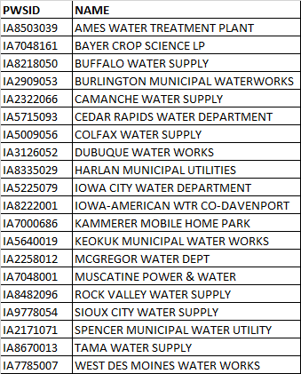
Systems On Quarterly Monitoring
Next Steps:
Tier 4 Sampling
BIL Money
Alternate water supply
New treatment systems
Notes:
In this first round of sampling 14 water supplies have been assigned quarterly monitoring.
West Des Moines, IOWA CITY, Rock Valley, Sioux City, Ames, Camanche, IOWA-AMERICAN DAVENPORT, Kammerer Trailer Court, Muscatine, BURLINGTON, KEOKUK, Tama, Cedar Rapids, Central City

Slide 28
Tier 4 Summary
Sampled 36 water supplies between March 8 and June 24, 2023
Results have been received for all water supplies
26 communities had no detections of PFAS
9 communities had at least one detect, but nothing above a Health Advisory
4 of these systems had detects of PFBS and have been, or will be, assigned quarterly PFAS monitoring
1 community had a detection above the PFOS Health Advisory
System will provide public notification and sample PFAS quarterly
Next Steps – Tier 5?

Slide 29
PFAS and Private Wells

Slide 30
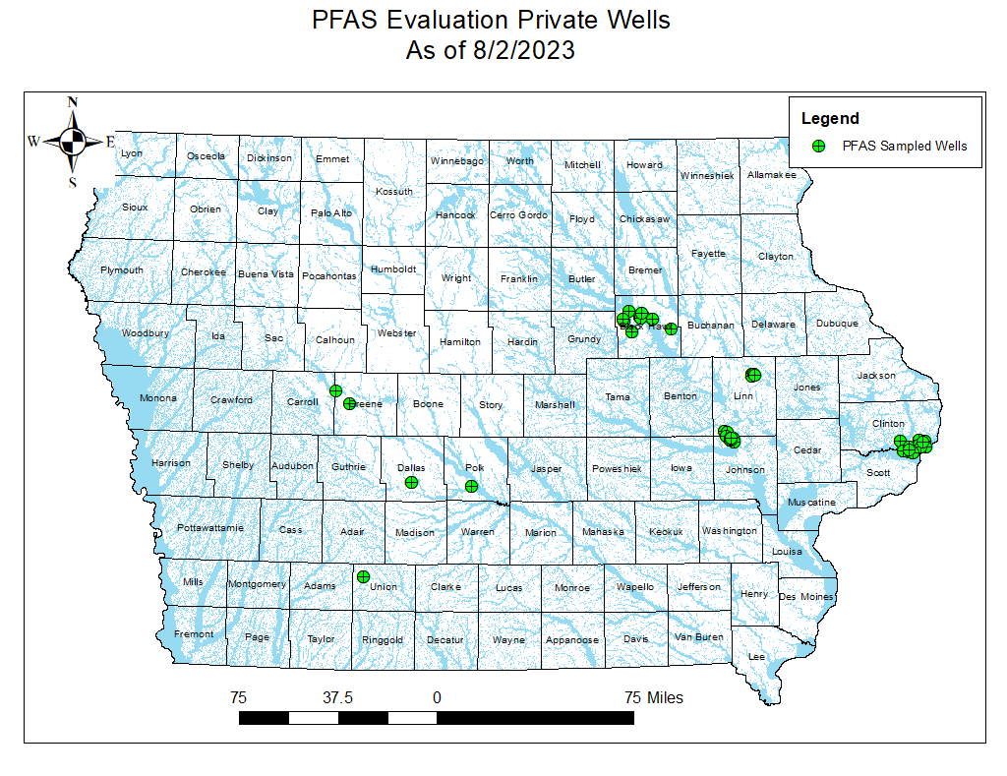

Slide 31
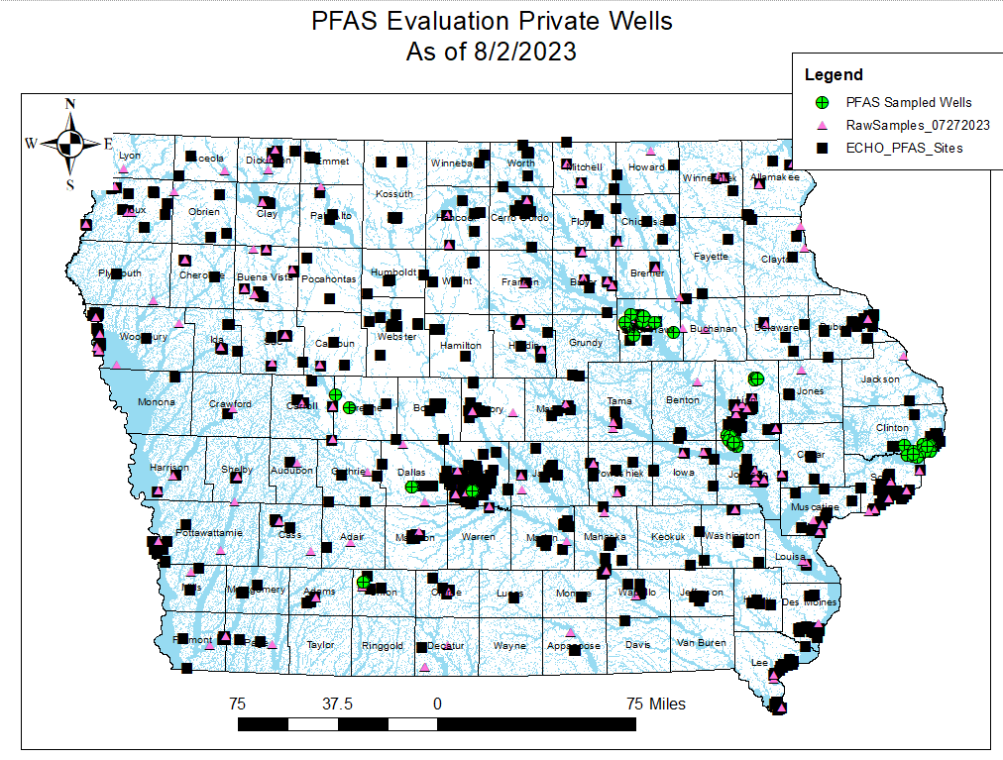

Slide 32
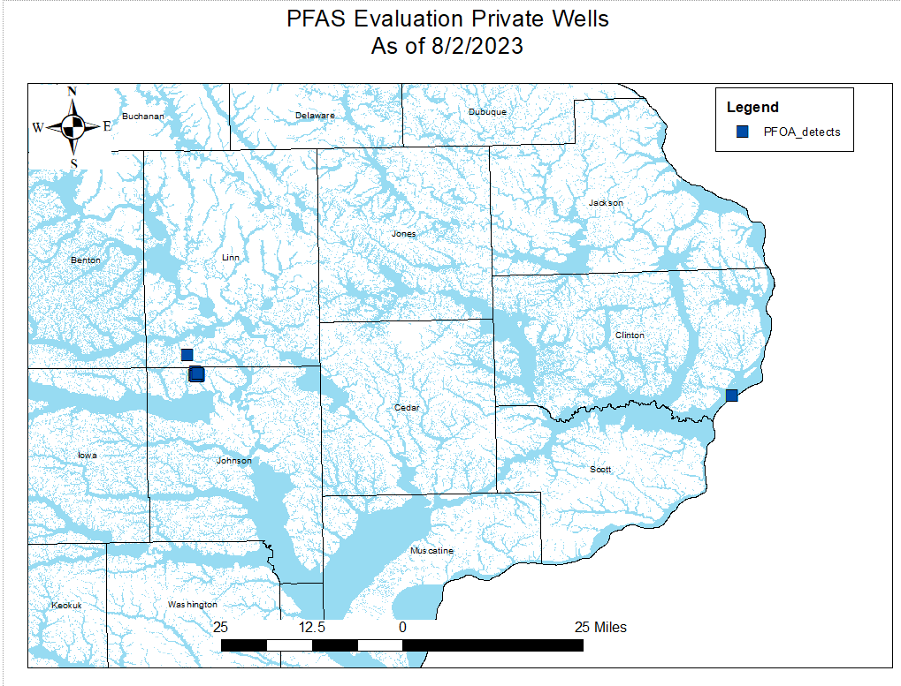

Slide 33
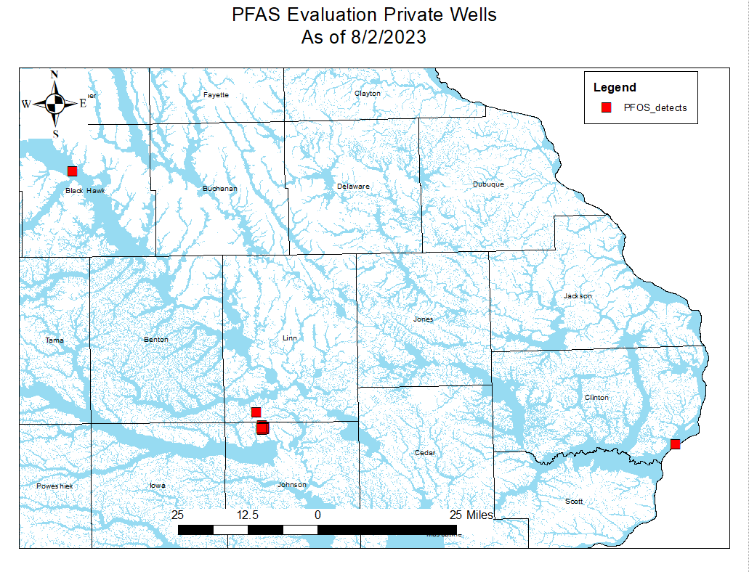

Slide 34
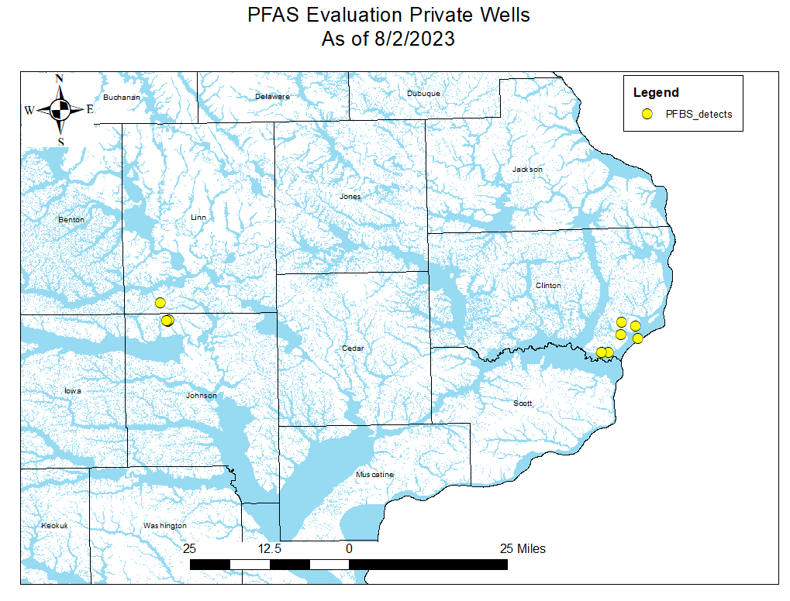

Slide 35
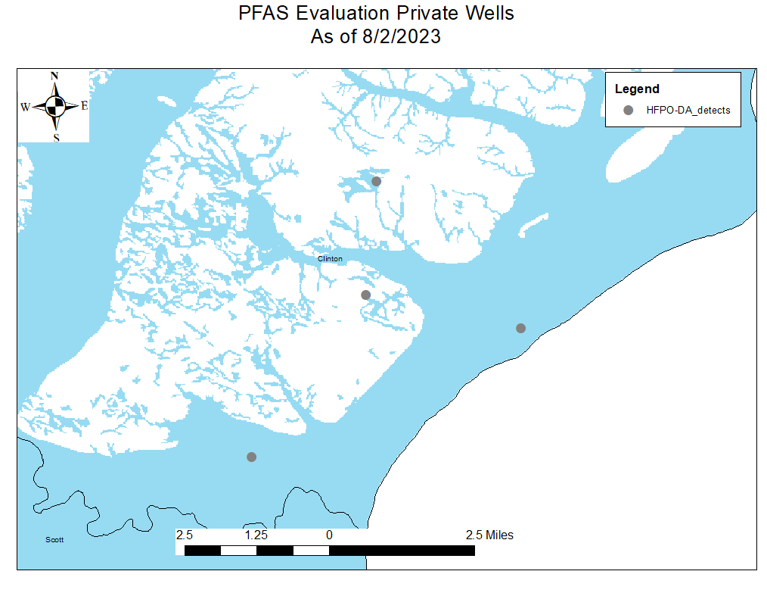

Slide 36
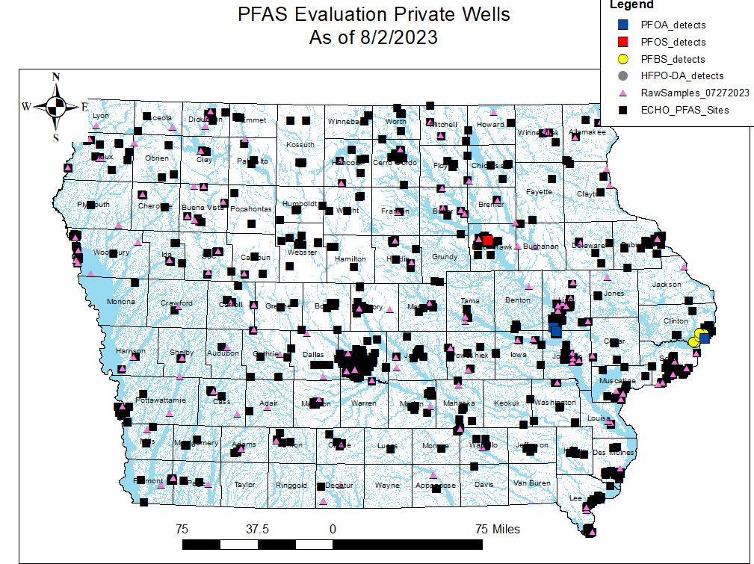

Slide 37
PFAS in Wells (untreated groundwater)
Notes:
Update to include Tier 3 – to date
Fingerprintable!
Alluvial wells along Mississippi look more like surface water

Slide 38
End of Presentation

